Slide 1


Steering through Tunnels
From https://www.pexels.com/photo/woman-sitting-in-vehicle-3007318/

Slide 2
Learning Goals
Understand what we mean by ‘steering through a tunnel’
Know the differences between Fitts’ Law and Steering Law
Being able to determine the time to steer through a tunnel
Steering through Tunnels

Slide 3
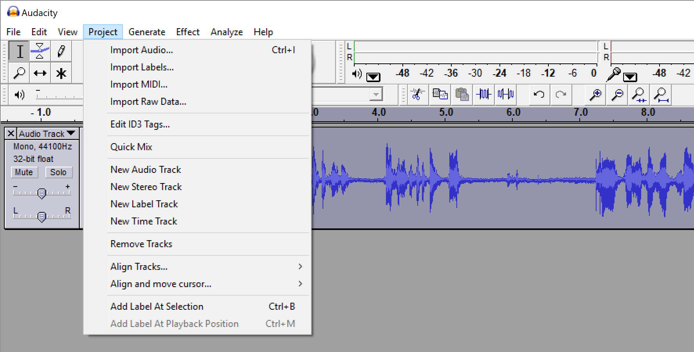

distance
Steering through Tunnels

Slide 4
Menus
Steering through Tunnels

Slide 5
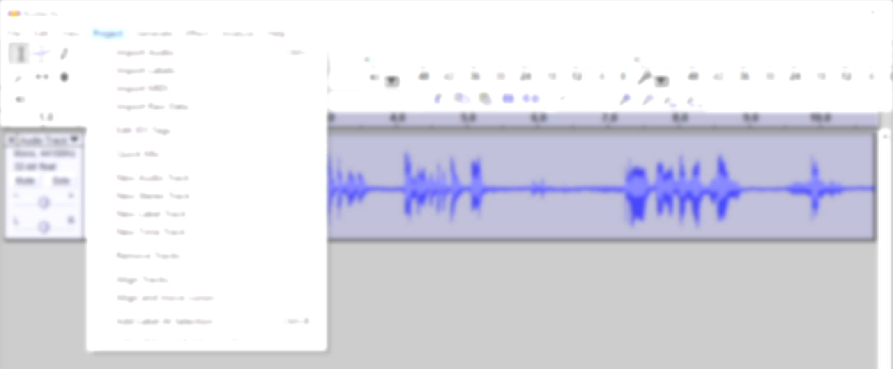
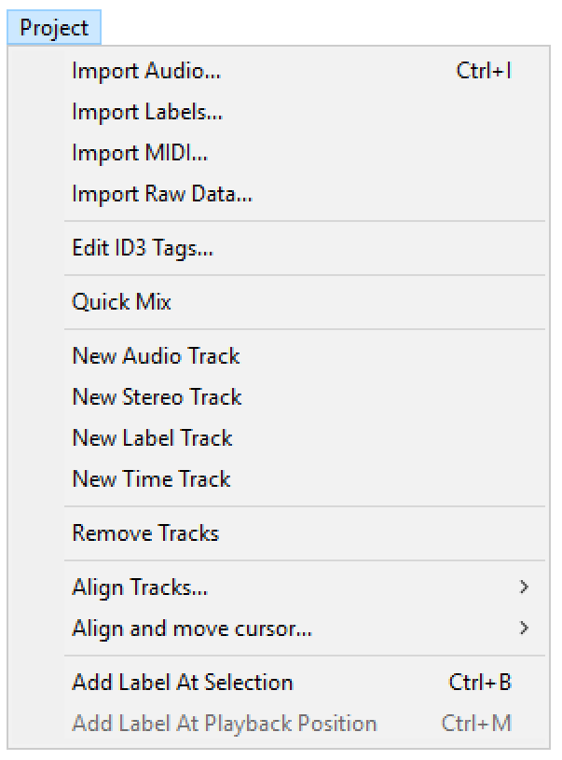
Selecting a Menu Item
distance
width
Steering through Tunnels

Slide 6
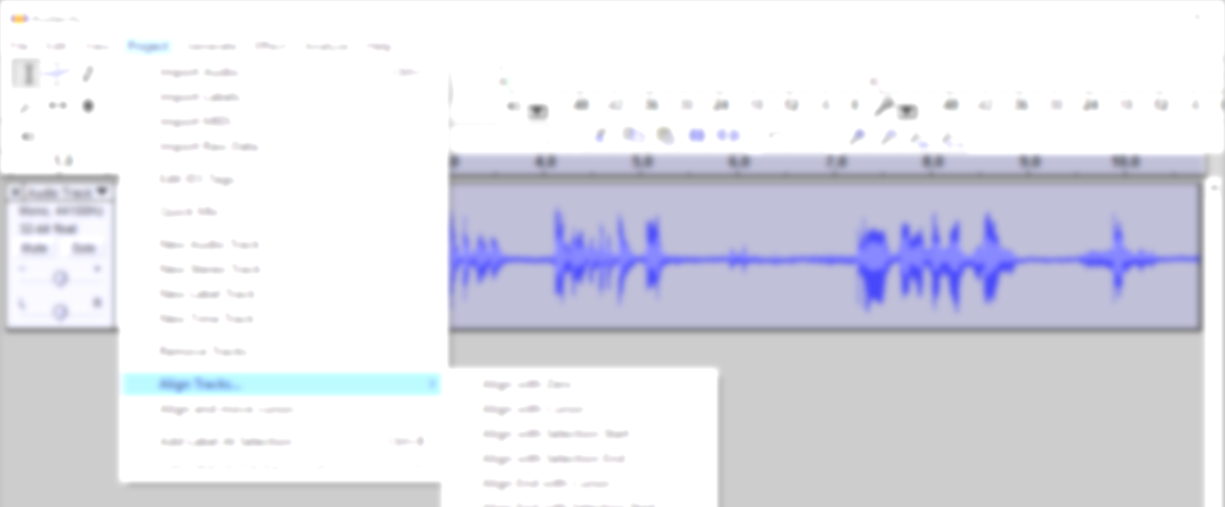
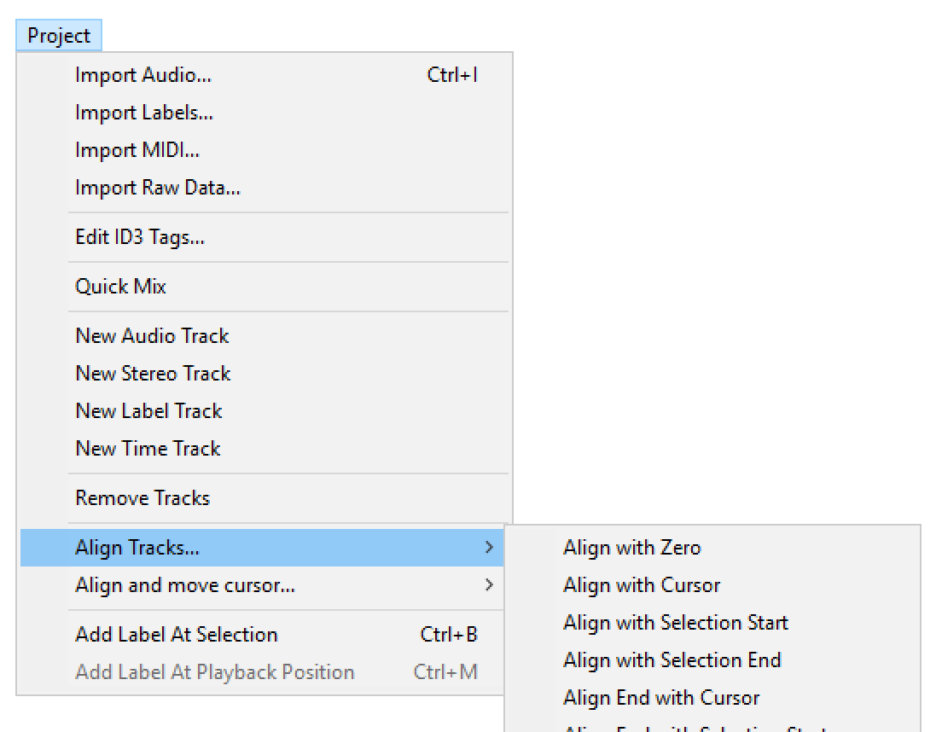
Selecting a Sub-Menu
Steering through Tunnels

Slide 7

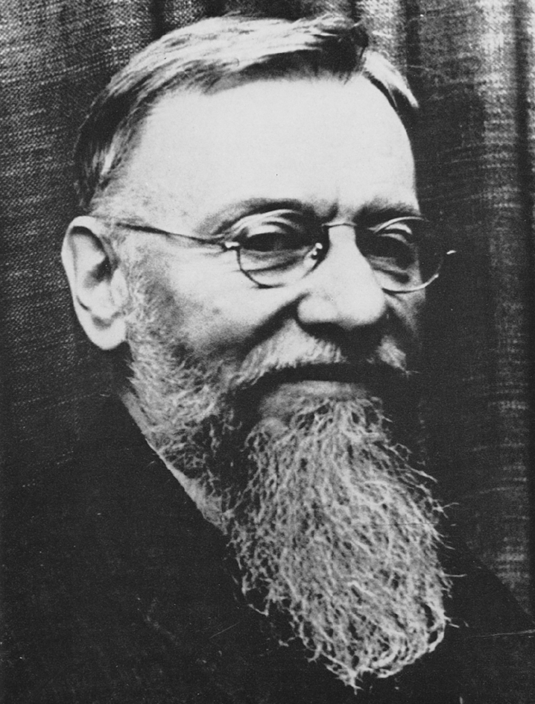
Steering a Car
Bartholomay, A. F., Karreman, G., & Landahl, H. D. (1972). Obituary of Nicolas Rashevsky. Bull. Math. Biophys, 34, 1.
By Deva Darshan from https://www.pexels.com/photo/aerial-view-of-road-in-the-middle-of-trees-1173777 (PD)
Steering through Tunnels
Notes:
Nicolas Rashevsky was a theoretical physicist and a pioneer of mathematical biology. In his paper “Mathematical biophysics of automobile driving” he made one of the first attempts to formally describe the process of steering a car on a (curvy) road.

Slide 8

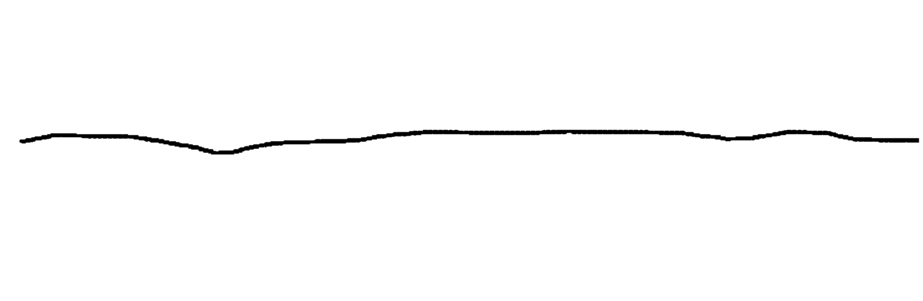

Steering a Mouse
distance
width
Accot, J., & Zhai, S. (1997). Beyond Fitts' law: models for trajectory-based HCI tasks. CHI’97
Steering through Tunnels

Slide 9
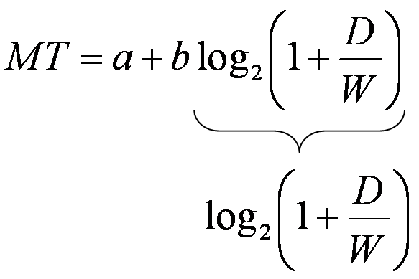
Steering vs. Pointing
distance
What is easier, steering through a tunnel or target selection?
width
distance
width
Steering through Tunnels

Slide 10
Steering Law
distance
How to change Fitts’ Law to model steering tasks?
width
From: http://www.amisducena.fr /authors/accot_johnny.shtml
Steering through Tunnels

Slide 11
(Accot–Zhai) Steering Law
Steering through Tunnels

Slide 12
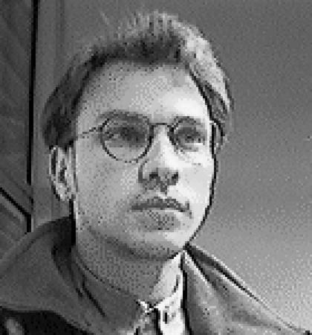
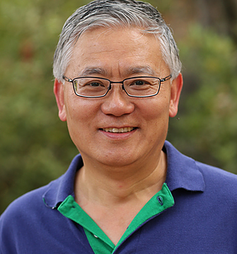
(Accot–Zhai) Steering Law
Accot, J., & Zhai, S. (1997). Beyond Fitts' law: models for trajectory-based HCI tasks. CHI’97
From: http://www.amisducena.fr /authors/accot_johnny.shtml
By Kearniel from https://commons.wikimedia.org/wiki/File:Shuminprofile.png (CC BY-SA 4.0)
Steering through Tunnels

Slide 13
Steering Law Definition
Accot, J., & Zhai, S. (1997). Beyond Fitts' law: models for trajectory-based HCI tasks. CHI’97
ID=
The movement time (MT) to acquire a target through a tunnel is a function of the length (D) and width (W) of the tunnel. It depends on the input device.
MT: movement time
a and b: constants dependent on the pointing system
D: distance, i.e. length of the tunnel
W: width of the tunnel
Steering through Tunnels

Slide 14
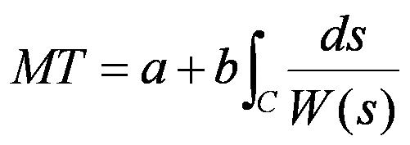
Steering Law Extensions
Accot, J., & Zhai, S. (1997). Beyond Fitts' law: models for trajectory-based HCI tasks. CHI’97
Steering through Tunnels

Slide 15
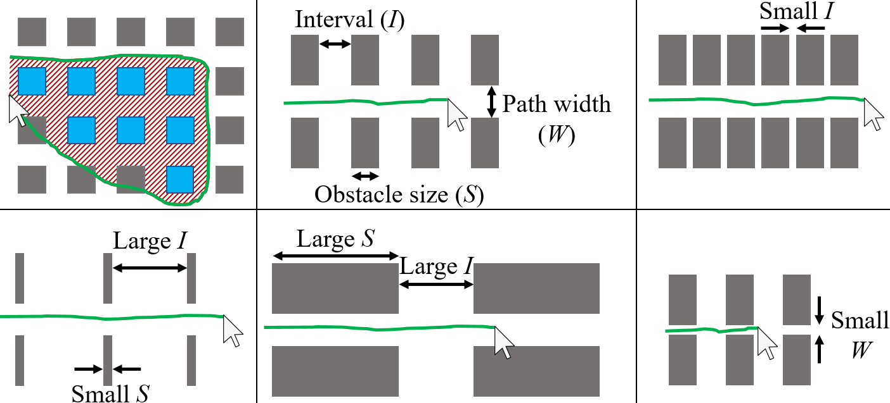
Steering through Successive Objects
Yamanaka, S., Stuerzlinger, W., & Miyashita, H. (2018, April). Steering through successive objects. CHI’2018.
Steering through Tunnels

Slide 16
Steering Law for Driving
Zhai, S., Accot, J., & Woltjer, R. (2004). Human action laws in electronic virtual worlds: an empirical study of path steering performance in VR. Presence: Teleoperators & Virtual Environments, 13(2), 113-127.

Slide 17
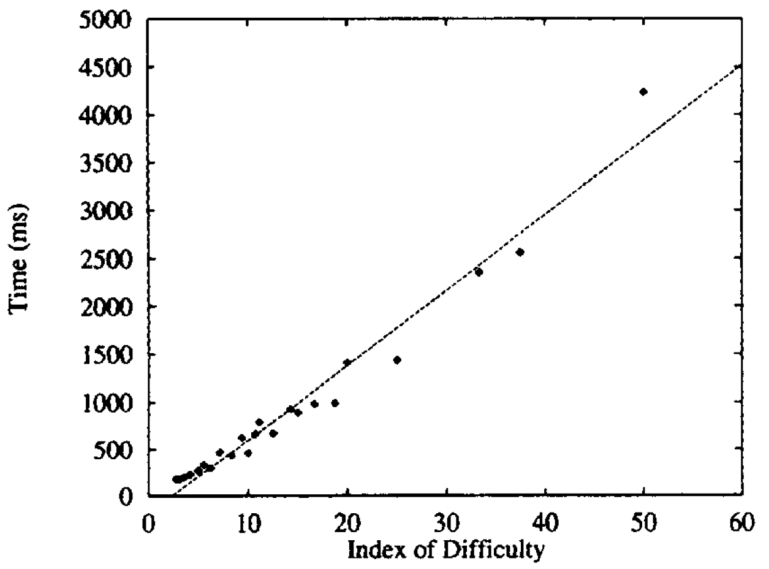
What are a and b for this steering task?
Accot, J., & Zhai, S. (1997). Beyond Fitts' law: models for trajectory-based HCI tasks. CHI’97
Steering through Tunnels

Slide 18
License
This file is licensed under the Creative Commons Attribution-Share Alike 4.0 (CC BY-SA) license:
https://creativecommons.org/licenses/by-sa/4.0
Attribution: Niels Henze
For more content see: https://hci-lecture.de

